Slide 1
Handwritten Character Classification
Using Tensorflow and Keras

Slide 2
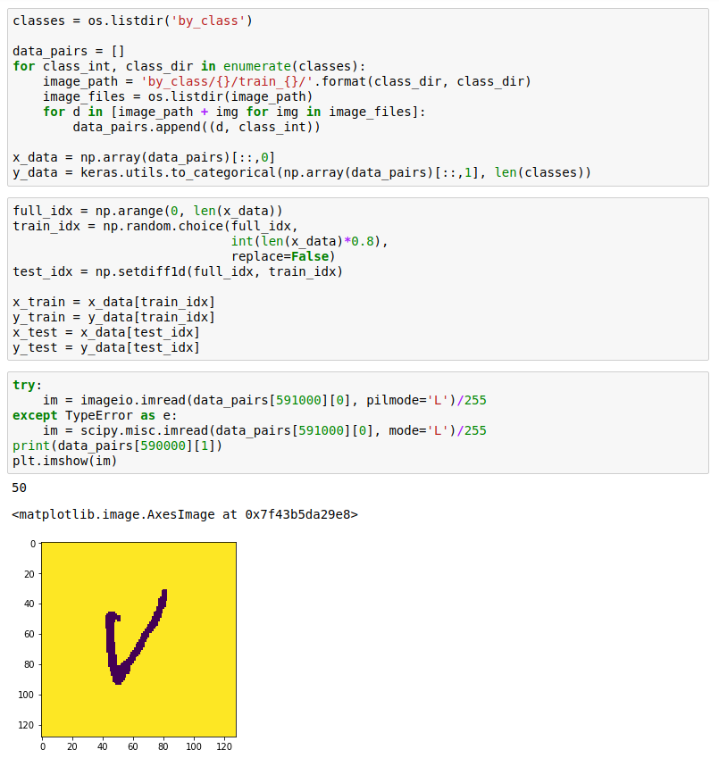
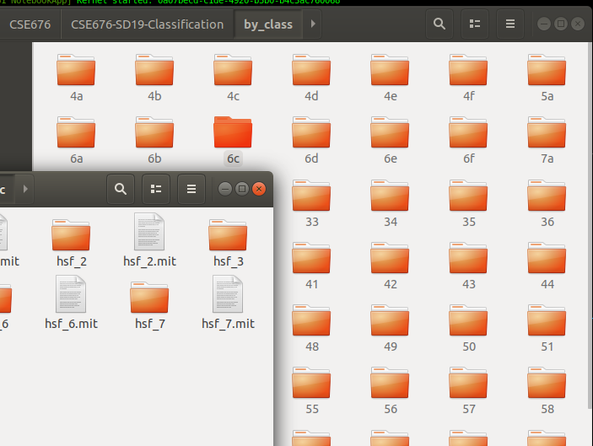
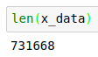
Data Preparation
First, we import the data and organize it into feature and label sets.
We start by iterating over the subdirectories of the main ‘by_class’ directory we downloaded
Each subdirectory contains images of handwritten characters (one class per directory)
We save an incrementing integer (encoded as one-hot) as the label data, and a path to the image as the feature data
We split the data in an 80/20 split, where 80% of the (randomized) data is for training, with the rest is for testing

Slide 3
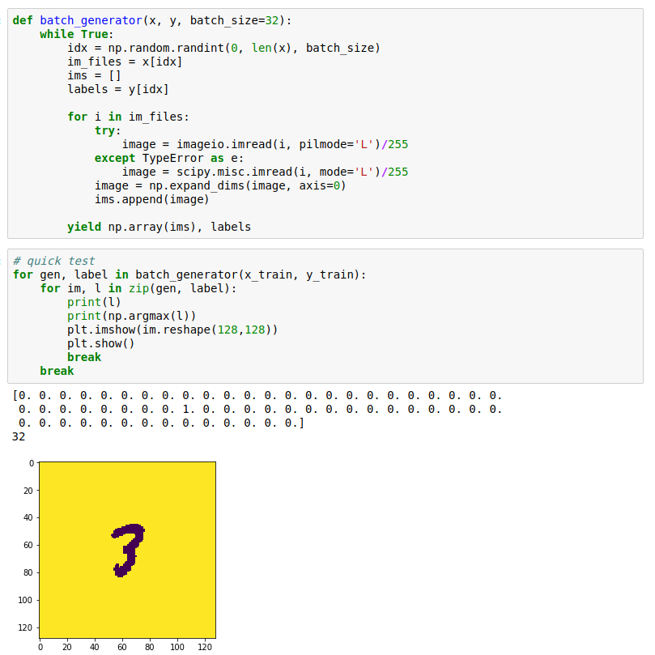
Batch Generation
Since we’re dealing with a lot of large data, we create a generator function to load the data in as necessary.
We pass through the feature and label sets we created before
It pulls a random batch from the sets of data, and loads the necessary image data in
Here, we test it and see how the X and Y data look for a single example

Slide 4
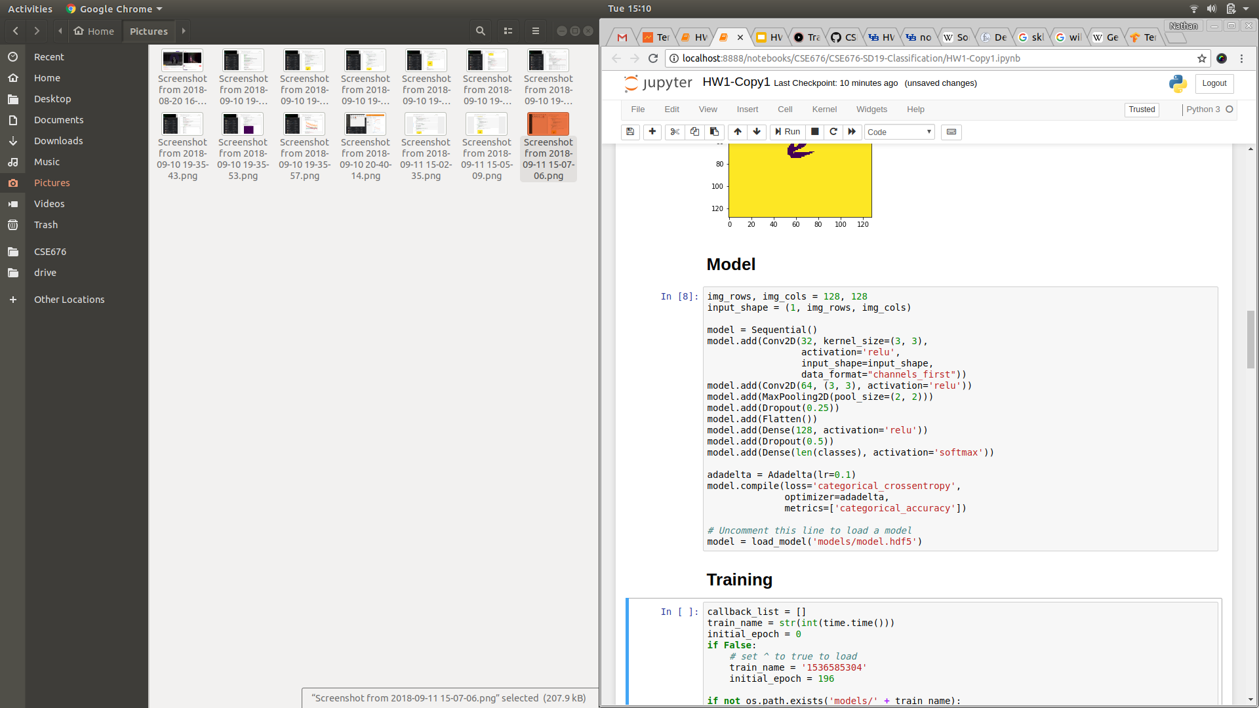
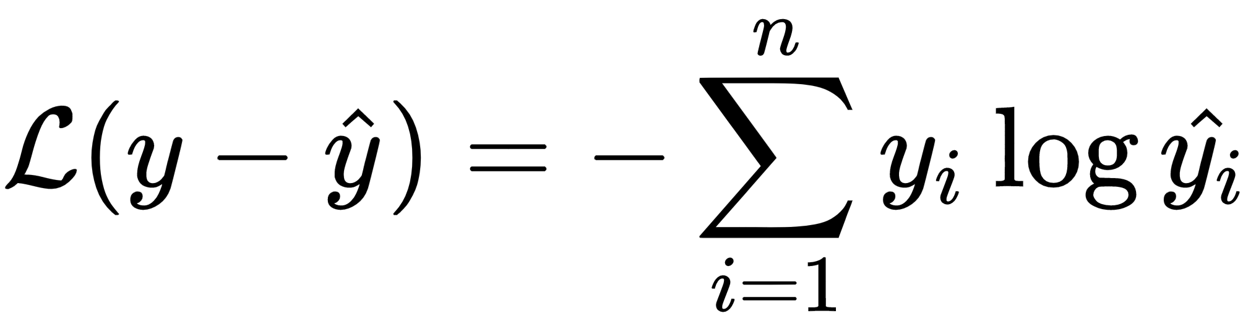
Model
Next, we create a CNN using Keras
We start by creating an instance of Keras’ Sequential class
We add various layers (Conv2D, MaxPooling2D, etc.) to the NN
We compile the model using categorical cross entropy as the loss function and AdaDelta as the optizer
We also keep track of categorical accuracy as a metric
If we have saved a previous model, we can load it using Keras’ load_model function

Slide 5
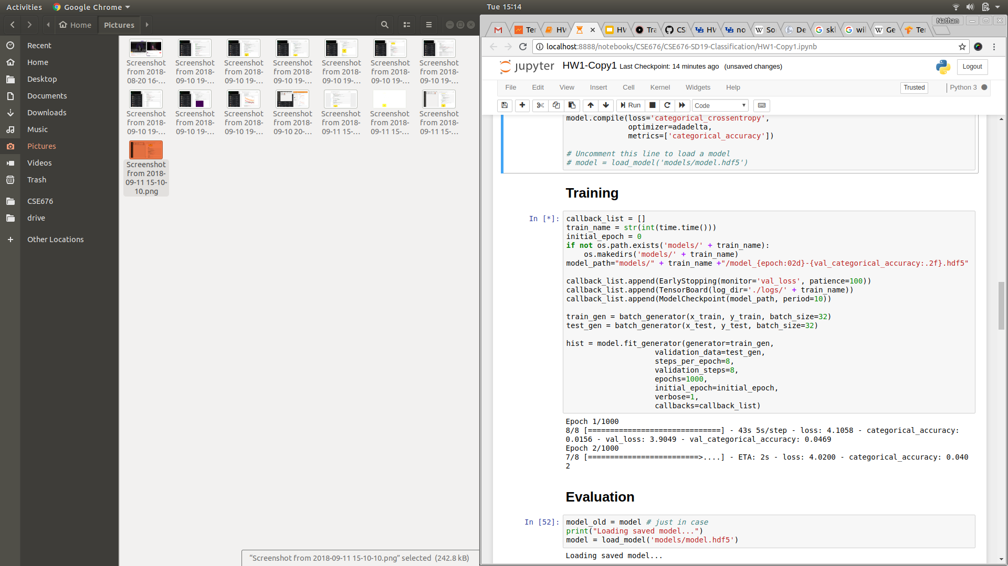
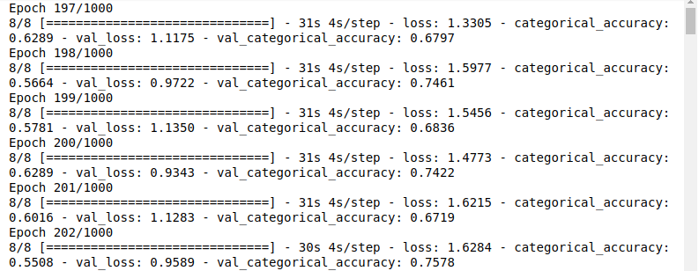
Training
We set up training for our newly compiled model
We create instances of a number of Keras’ callback classes (EarlyStopping, Tensorboard, and ModelCheckpoint)
We create an instance of our generator for both the training data and the test data
We use the model’s fit_generator method to start training

Slide 6
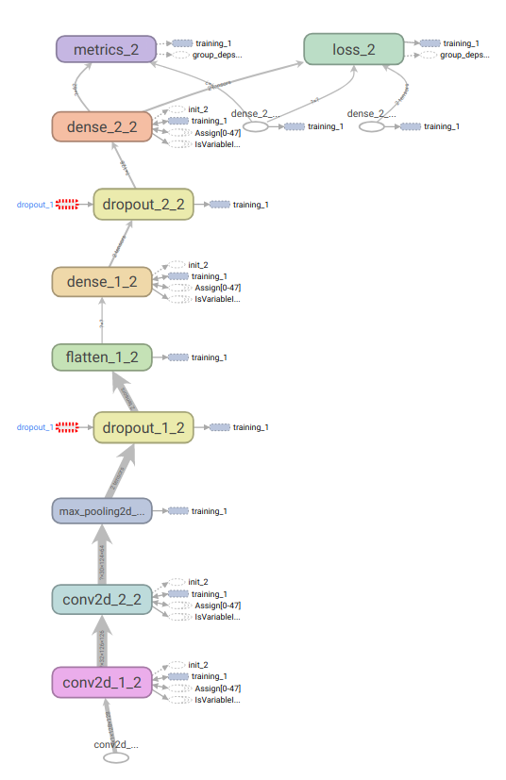
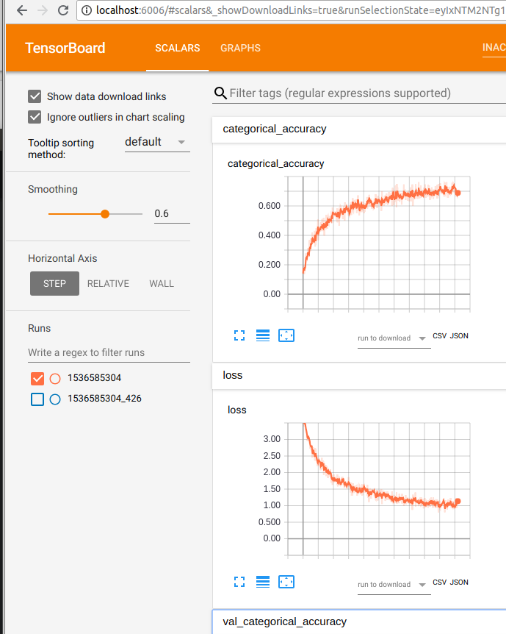
Tensorboard
One of the callbacks we used was TensorBoard
TensorBoard allows us to watch the training metrics while it’s in progress
Once the model is training, run the following in the command line:
tensorboard --logdir=path/to/log-directory
Then, navigate to “localhost:6006” in a web browser to watch the training progress
TensorBoard also offers a number of different tools to visualize and debug Tensorflow training

Slide 7
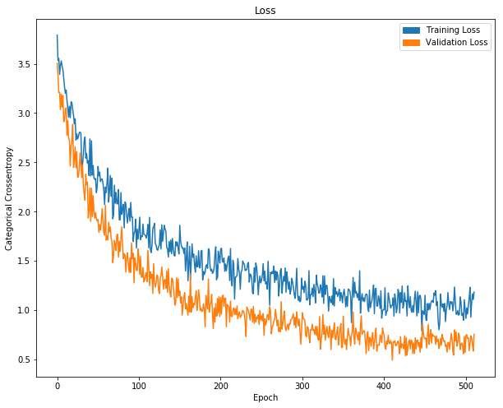
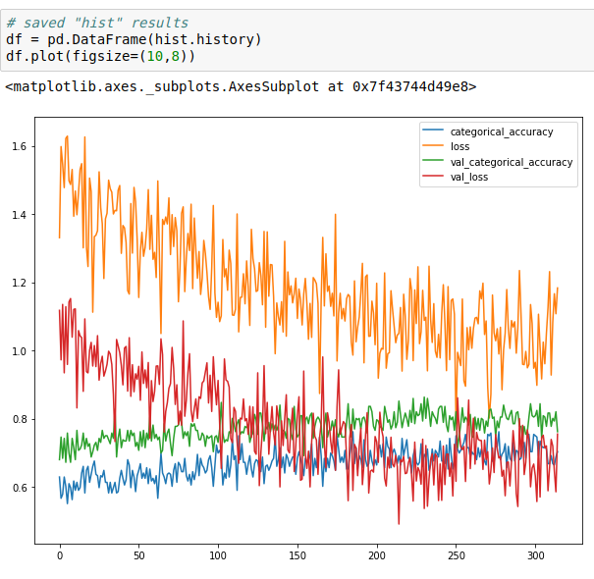
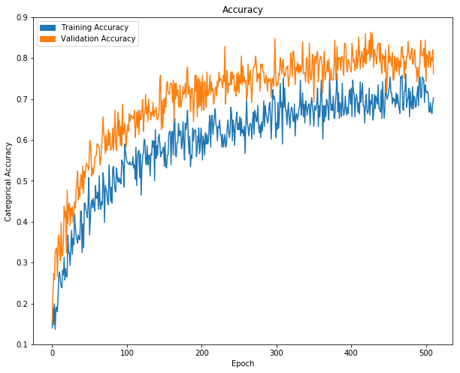
Visualizing Training
We can see the generated training data for the training run by plotting from the history of returned value of the fit_generator function.

Slide 8
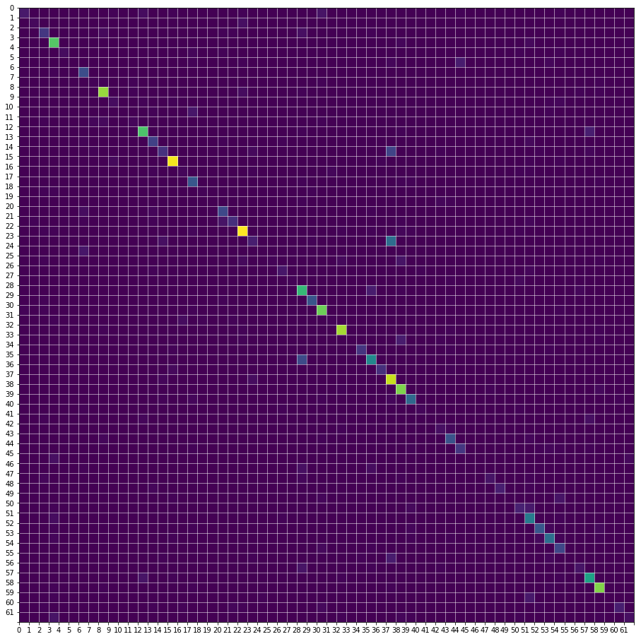
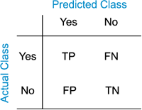
Confusion Matrix
We create a fusion matrix to visualize the model’s performance
We collect some prediction samples made by the model on the test data
We use scikit-learn’s confusion_matrix function to generate a confusion matrix
Class ‘23’ corresponds to ‘k’
Class ‘37’ corresponds to ‘T’
https://en.wikipedia.org/wiki/Gene_expression_programming

Slide 9
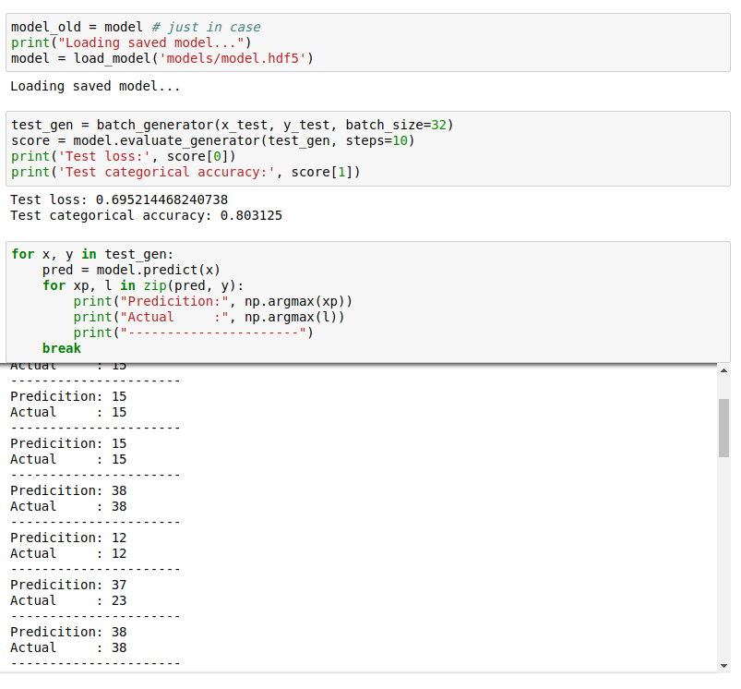
Accuracy Evaluation
We test the accuracy of the model we trained.
We can use the model’s evaluate_generator method on the test data to get the model’s moss and accuracy
We can use the model’s predict method to generate predictions given test feature (image) data

Slide 10
Challenges
While Keras makes building and training the model relatively easy, deciding which hyper-parameters to use proved to be the most challenging aspect of the task.
The architecture of the model itself forces us to make many parameter decisions
Parameters for things like the optimizer and loss functions add to these complications
Even then, there are many parameters associated with training that dictate the success of the model.
Watching training metrics in Tensorboard allows us to visualize the process and adjust these parameters accordingly
Still, many of the decisions were made via “guess and check,” which is very time consuming

